Slide 1
People- Mindsets and Behaviors
Playbook Learning Series
18-January-2021
Notes:
Recommend, having two sessions, one hour each. 1st session covers the Influencing Model and Feedback, 2nd Session is a follow up to Feedback and discusses Coaching and Mentoring.
Talking Points:
Welcome to “Today’s People - Mindsets and Behaviors” Discussion and Engagement Platform

Slide 2
ASCEND Manufacturing Excellence at Cardinal
Detail to follow
Performance and Capability
Execution mechanisms
Standards/ways of working
OEE/
Asset productivity
Labor Productivity/ Organization efficiency
World-class maintenance
Material
Productivity
Core capabilities
Intelligent planning and scheduling
Teamwork
Daily Management System
6S
Continuous
improvement
Safety
Delivery
Quality
Foundational elements
People - Mindsets and Behaviors
F8
Notes:
Talking Points: People are the foundation of our business, without our employees, our patients, our Customers we couldn’t do what we do.
As you are on your journey with Manufacturing Excellence, recognize that to be successful it is important that our teams are engaged and valued. Their input, energy, ideas, and collaboration will be just as important as their willingness to try new things and give it 110%.
Additional Talking Point if needed: Cardinal’s Health Groundwork are People. People are the most essential aspect to our company and our success. People’s mindsets and behaviors will allow us to build a capitalizing organization for today and the future. We begin building by pouring our house’s “Foundational Elements” of Safety, Delivery, Quality and layering Teamwork, Daily Management, 6s and Continuous Improvement. We will continue to construct by incorporating pillars of Asset Productivity, Organization Efficiency, World-class Maintenance and Material Production. Finally, execution of Standardization, Performance and Capability will top off our house.
Reminders: As you lead this module, keep in mind who the audience is. People leaders will often face challenges with change in processes and new initiatives even if solutions are developed by their own teams. This module is designed to be motivational and provide resources for change, coaching and feedback that will change mindsets and drive positive behaviors for success.

Slide 3
People- Mindsets and Behaviors
Agenda for today
Ground rules
Review how mindsets and behaviors affect the way we work
This is an open discussion, so feel free to ask questions and share your experiences
Discuss ways we can work to improve mindsets and behaviors, allowing the organization to ASCEND to the next level of performance
Mentoring
Coaching
Feedback
Influence model
We learn best by doing things, which means everyone is expected to participate
A
S
C
E
N
D
Notes:
Talking Points: Today’s agenda includes sharing/discussions about how mindsets and behaviors affect how we work daily
We will also look at and learn the 4 components (Influence model, feedback, coaching and mentoring) to improve/enhance our mindset, behaviors and to help the organization ascend to the next level
2 ground rules before we get started: First this is an open discussion so feel free to share and ask a lot of questions. Secondly, we want to learn from everyone’s participation and conversations.

Slide 4
Professional Development Academy
Learning and Development COE
Leading the Cardinal Health Way
The 6 Critical Practices for Leading a Team
Leading the Cardinal Health Way is an Interactive leadership development program for new people leaders (external new hires or internal promotions) that includes a one-day live event of Instructor-led training.
Designed to accelerate performance, drive engagement and increase retention. Increases speed to competency on how a leader uses tools and resources to successfully lead at Cardinal Health. Teaches the "what" and "how."
Key topics include:
Diversity & Inclusion
Leader as a Coach
Leadership Essentials
Manage Expectations
Talent Acquisition
Provide Feedback
Manage Performance
Rewards & Recognition
This course is ideal for first-time people leaders who have transitioned from individual contributors to leading others and existing leaders who are looking for practical, relevant resources to effectively lead and manage their teams.
Watch for offerings in mySpark! Classes fill up quickly and new classes are added frequently!
Also watch for special offerings for your site.
Notes:
Talking Points:
If you have not already done so, there are two courses available in mySpark that are a must to have in your leader toolbelt. These courses will not only set you up for success at Cardinal Health as a leader, but they will provide you with valuable tools and resources as well as networking opportunities to collaborate with other people leaders across Cardinal Health.
We highly encourage you to get registered for an offering made available to you before the end of the fiscal year. Your dedicated learning team will also be working to bring in more opportunities for these courses to be delivered to our manufacturing teams regionally. Stay tuned, but don’t wait, these seats fill up fast. If you see an opening grab it.

Slide 5
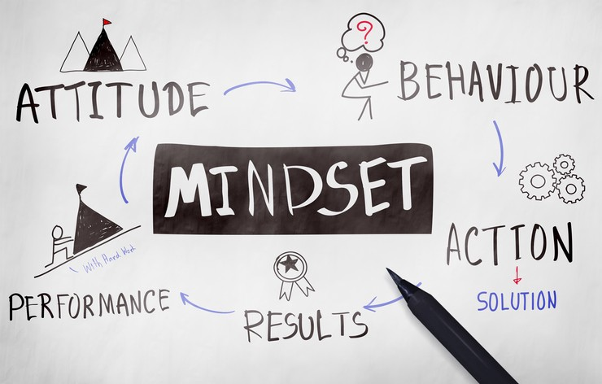
Theory behind mindsets and behaviors
Notes:
Talking Points: Let’s look at today’s theory of mindsets and behaviors.

Slide 6
What we see is the behavior, what we want to get to is the mindset
What we can observe, describe, and register
It is usually what is attempted to be addressed
Behavior
Under the surface
Thinking and feeling
Thoughts and feelings – both conscious and unconscious
Values and beliefs
What’s important – values, assumptions, beliefs, priorities
Identity, needs (met and unmet), and fears
Underlying needs, including fears and threats to our identity
It is necessary to address both visible and hidden drivers to understand and change behaviors and mindsets
Notes:
This slide is animated: Behavior (everything above the surface) will appear automatically. This will allow time to discuss behavior.
1st Click: Thinking and Feeling will appear.
2nd Click: Values & Beliefs will appear.
3rd Click: Identity, needs (met and unmet), and fears will appear.
4th click: Bottom sentence will appear.
Talking points:
We all can see “behaviors” (conduct, body language, hear tone etc.) but can we see the “signs” of a person’s mindset? How they are feeling (aware or unaware), what they value-believe, their needs, fears etc. It is crucial to understand behavior and what is driving it to effectively incorporate change
Behavior – is observable, we can see it, describe the behavior and register it. Behaviors are usually what we attempt to address.
Mindset differs as it leads to things under the surface. Thoughts, feelings, both conscious and unconscious. (Do we have unknown bias)
Also, part of what makes up our mindset about something is our values, beliefs, our assumptions as well as our priorities
Another factor can be our identity and underlying needs, fears and threats to our identity can affect our mindset.
It is necessary to address both visible and hidden drivers to understand and change behaviors and mindsets.

Slide 7
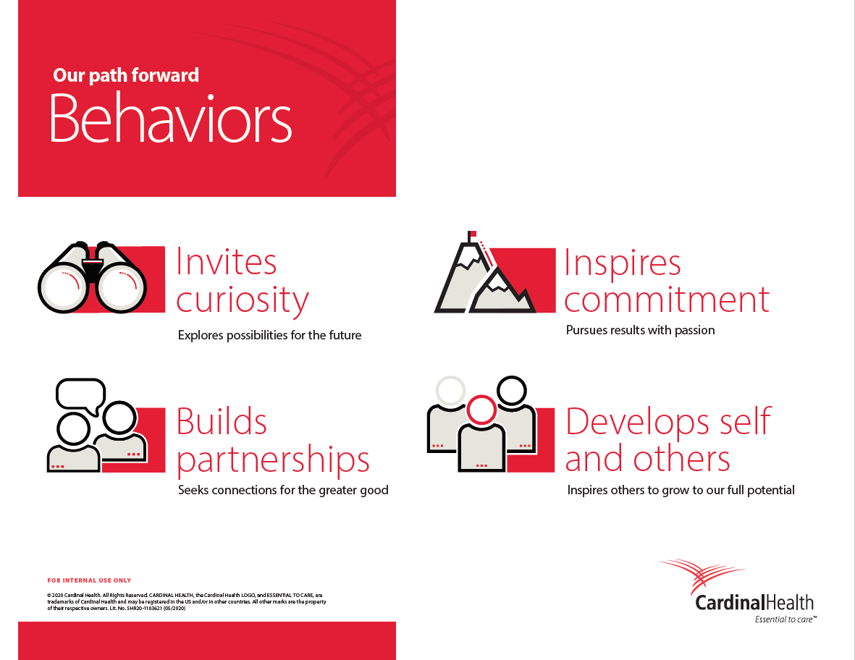
Notes:
Slide is animated: 4 clicks with each of the behaviors appearing one after the other in order to allow you to use the speaker notes to help further explain the intent of the behaviors.
Beginning in FY21, we will have four new Behaviors, which will replace our ‘Leadership Essentials.’ We are making this change because we believe these four Behaviors will help us accelerate future success.
----------------------------
[Including context, in case questions are received regarding why/how these were created]
The behaviors are designed to help us achieve our business strategy.
In the creation of these, we asked leaders what competencies or behaviors are needed for Cardinal Health for our future.
Recognize that the intent here is not to ask about what leaders embody today. Instead, what will make us successful in the future?
Over 30 senior leaders spent time sharing their thoughts, and after many conversations to adjust and refine, we have four behaviors that you will learn, exhibit, role model, and teach others throughout the organization – so that we can achieve our strategy and the results expected of us as a company.
----------------------------
Invites curiosity
Team members who invite curiosity help us as a company to explore possibilities for the future and challenges the notion of “we have always done it this way” and “we have tried that in the past.”
Shows confidence and courage to figure out new solutions
Maybe you come to group discussions with new ideas and solutions that can help move your team forward, rather than focusing on problems and limitations.
Builds partnership
Builds partnerships is about seeking connections for the greater good. Maybe that means instead of just focusing on your own team’s goals or even your personal goals, you approach all situations as opportunities to accomplish company goals.
It could also be demonstrated in the way that you make an effort to understand why other people or groups think or do certain things – so that you can create connections between your own work and what others are doing.
Identifies opportunities to bring others together to share information. Encourages the respectful exchange of diverse perspectives and ideas to reach more thoughtful outcomes.
Inspires commitment
Next up is inspires commitment by pursuing results with passion. Someone who displays this behavior will be driven to accomplish meaningful goals. They’ll deliver on promises to internal and external stakeholders, and they’ll demonstrate a real commitment to company priorities.
Models a persistent desire to excel and does not make makes excuses for missed goals. Coaches others on the importance of working smarter, not necessarily longer hours.
Develops self and others
Our last behavior is develops self and others. By that we mean inspiring others to grow to their full potential, so that we as a company can reach our full potential. In practice, this will be someone who demonstrates self-awareness, and seeks feedback from others. This is someone who takes feedback and looks for ways to make improvements in their day to day work.
Demonstrates the ability to build and encourage the talents of a diverse team when driving results. Quickly helps new employees assimilate and contribute.
Speak to vulnerability. It is very important for each of us to be aware of our strengths and development needs as people leaders. Let’s create connections for our employees to understand what the Behaviors mean to each of us personally.

Slide 8

Behaviors for individual contributors: Invites Curiosity
INVITES CURIOSITY
Contributes to discussions by focusing on what is possible rather than what does not work or getting lost in the details.
Shares thoughtful ideas for enhancing existing processes and introducing new opportunities.
Shows an eagerness to understand new information and changes that may affect their day to day work and team.
Shows an understanding of what is happening beyond their daily work and team. Demonstrates a broad focus on the end customers we serve.
Notes:
Talking Points
Now let’s look at the behaviors from the individual contributor perspective.
Invites Curiosity – Within Manufacturing Excellence we are asking employees to be involved in the process.
We want them to ask questions, question their processes and develop new and better ways to drive efficiency, consistency and increase productivity.
Review the 4 bullets and ask if anyone have an example of how an employee might demonstrate these behaviors.

Slide 9

Behaviors for individual contributors: Builds Partnerships
BUILDS PARTNERSHIPS
Shows a passion for learning about Cardinal Health and demonstrates an interest in expanding their network.
Effectively partners and collaborates with others on assigned tasks. Seeks realistic ways to remove barriers to accomplish goals.
Seeks to understand other perspectives and listens intently. Asks questions to broaden understanding and establish connections between their work and others.
Regularly encourages the exchange of information with people in jobs that are connected to their own, so that work can be as effective and efficient as possible.
Notes:
Talking Points
We need to master the Builds Partnership behavior. When we all work together collectively as a team with the same goal(s) in mind we are building a much stronger workforce while also manufacturing much better products that help support our valued customers. Manufacturing Excellence will require collaboration, teamwork, research, and leaning on others as we build success in each site.
Builds Partnership – Review the 4 bullets and does anyone want to share and example of how they can build partnerships through out the Man Ex project?

Slide 10
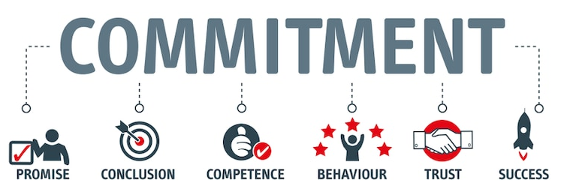
Behaviors for individual contributors: Inspires Commitment
INSPIRES COMMITMENT
Demonstrates an understanding of his or her role and how it adds value to the team and company. Quickly adapts as needed to provide increased contribution to priorities.
Shows confidence in raising issues early and identifying the best next steps. Action steps lead to effective results.
Remains calm when faced with changes to (and in) their work. Shows an ability to persevere.
Strives to contribute value in all they do, including delivering on commitments to others.
Notes:
Talking Points
Manufacturing Excellence will help us drive consistency in how we do things even though the products at each site and our equipment still varies. We want to develop a new culture, that involves sharing of best practices, creating streamlined processes and creating teams that inspire commitment not only to each other but to Cardinal Health.
Review the 4 bullets and ask how can you inspire commitment from your team as we go through the Manufacturing Excellence program?

Slide 11
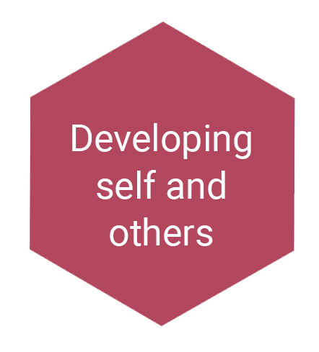
Behaviors for individual contributors: Develops Self & Others
DEVELOPS SELF AND OTHERS
Learns from the past and makes improvements. Takes ownership of any mistakes.
Demonstrates self-awareness. Accepts constructive feedback from others to improve performance. Incorporates insights for self-improvement.
Shows enthusiasm for taking on new or additional work. Views investment of time and effort as an opportunity to improve their skills and knowledge.
Models resourcefulness by reaching out to people within and outside the team to get work done effectively.
Notes:
Talking Points
We need to invest our teams and encourage them to invest in themselves and others. Everyone can learn something new and build upon their skills. As we move forward throughout Manufacturing Excellence there will be opportunities to learn from each other, our peers, while also collaborating with our teams, customers, and project teams. It’s a great opportunity to try different things to get the results we want.
Review the 4 bullets and how can your teammates learn from others? How can you help them and encourage development?

Slide 12

Tools to use to help mindsets and behaviors ASCEND
Mentoring
Coaching
Feedback
Influence Model
Notes:
Talking Points:
We will begin to move forward. Let’s look at the 4 components that will allow us to ASCEND as an organization and as a people.

Slide 13
The Influence Model - Examples
Influence model
Role modeling matters. We mirror individuals and groups who surround us – sometimes unconsciously and sometimes consciously
Role modeling
“I see my leaders, colleagues, and staff behaving differently”
Leaders are uniquely positioned to be influential role models due to the power of authority…
…but everyone has the power to influence – and we have tools to uncover hidden influencers in organizations
“I choose to change my mindset and behavior if …”
Individual influence can be strengthened – applying practical influence techniques can make anyone a more influential role model
Role modeling not only influences observers; it also influences the role modeler
Role modeling has a “dark side” – awareness of associated downsides can help organizations avoid risks and harness the power for good
Notes:
Talking Points:
Our first piece is “Role Modeling”
Read all 6 bullets.
Let’s have open discussion around these 6 bullets. Any comments? Listen to comments
What is one way we can lead by example in the area of Safety and Quality? (ex: picking trash off the ground, noticing items not in proper place etc.)
Re-read and emphasize “…But Everyone has the power to influence” Recognize individual’s powers, you don’t have to be a “people leader” to be a role model. A role model is simply someone who is “living” what you want to be
Re-read and emphasize “Role modeling not only influences observers; it also influences the role modeler” ..the more we practice the stronger we become. It helps to hold your own self ‘Accountable”. (Cardinal Health Values)
Example
Activity Option - Slide 13-16, great examples. Could break up into break out teams and discuss, then upon returning discuss as a larger group.

Slide 14
The Influence Model – Fostering understanding and conviction
Influence model
Fostering understanding and conviction
“I know what is expected of me – I agree with it, and it is meaningful”
Role modeling
“I see my leaders, colleagues, and staff behaving differently”
Fostering understanding and conviction is essential – never underestimate the power of rallying people together around a shared, meaningful goal
Our tendency to implicitly assume that others are aware and onboard can blind us. In reality, an explicit change story is essential to establish common ground
“I choose to change my mindset and behavior if …”
We are wired to respond to stories
What is said in a change story matters…
…but how the change story is crafted and cascaded is just as important
Individual and cultural differences impact how people respond to communication – learn to leverage, rather than smooth over, these nuances
Notes:
Talking Points:
Our 2nd piece is “Fostering Understanding and Conviction”
Let’s talk about “Fostering understanding and conviction is essential” What does that statement mean to you? Does this give us an opportunity to be “Inclusive”? (Cardinal Health Values)
Is it true that we have a “tendency to assume that others are aware and onboard”? How can we change that?
Is there power in a “change story”?
Activity Option - Slide 13-16, great examples. Could break up into break out teams and discuss, then upon returning discuss as a larger group.

Slide 15
The Influence Model - Examples
Influence model
Fostering understanding and conviction
“I know what is expected of me – I agree with it, and it is meaningful”
Role modeling
“I see my leaders, colleagues, and staff behaving differently”
Associations and consequences shape behavior – even when not directly administered
All too often organizations incentivize the wrong things – and inadvertently overlook reinforcing the right things
“I choose to change my mindset and behavior if …”
Money alone won’t cut it…
Reinforcement mechanisms
“Barriers are being removed and I am being recognized for making the changes I am being asked to make”
…in fact, non-financial incentives and situational factors can be even more powerful
How reinforcements are delivered is important – in terms of overall strength of impact as well as perceptions of fairness
Notes:
Talking Points:
Our 3rd piece of the puzzle is “Reinforcement Mechanisms”
Most people and companies have a misconception that “money” is what everyone wants. “Money alone won’t cut it” ”...in fact, non-financial incentives and situational factors can be even more powerful” Do you agree or disagree?
“How reinforcements are delivered is important” do you agree or disagree?
“All too often organizations incentivize the wrong things” Is this true? Why does this happen?
Reinforcement mechanisms can and will “Inspire Commitment” – Cardinal’s Health Behavior
Activity Option - Slide 13-16, great examples. Could break up into break out teams and discuss, then upon returning discuss as a larger group.

Slide 16
The Influence Model - Examples
Influence model
Fostering understanding and conviction
“I know what is expected of me – I agree with it, and it is meaningful”
Role modeling
“I see my leaders, colleagues, and staff behaving differently”
…but don’t stop there. The best training programs are designed to take how adults learn into consideration
Yet all too often we lack insight into what we don’t know (but need to)…
“I choose to change my mindset and behavior if …”
…and further handicap ourselves by doubting our ability to enact change
Simple encouragement and feedback go a long way…
Reinforcement mechanisms
“Barriers are being removed and I am being recognized for making the changes I am being asked to make”
Developing talent and skills
“I have the skills and opportunities to behave in the new way”
Notes:
Talking Points:
Our final piece is “Developing talent and skills”
This starts with YOU! You continue to learn, grow, stretch, stay flexible, plastic. If you are “stagnant you will lead stagnantly.
Direct your development efforts in the right direction. Don’t just “check the box”.
Read the 5 bullets. Ask “where do you see yourself”? “Which one applies to you”?
Activity Option - Slide 13-16, great examples. Could break up into break out teams and discuss, then upon returning discuss as a larger group.

Slide 17

Tools to use to help mindsets and behaviors ASCEND
Mentoring
Coaching
Feedback
Influence Model
Notes:
Talking Points:
Our 2nd component to ascension is “Feedback’.

Slide 18
Feedback, coaching, and mentoring can all help to change people’s mindsets and behaviors
Feedback
Description
An ongoing relationship in which the mentor is a role model, a wise friend and counselor
Personal
3
Mentoring
Usually, a repeated interaction that aims to enhance the performance and learning ability of others
Professional
2
Coaching
Robustness of Relationship
Could be a single interaction; necessary to create awareness
1
Feedback
Stranger
One-off
Repeated
Long term
Duration of Interaction
Notes:
Talking Points:
There are 3 levels in which we provide information or influence in changing mindsets and behavior. In this section, we want to first focus on feedback. Then we will cover coaching and mentoring as we progress.
“Feedback” is our 1st step in our “Robustness of Relationship”. It is a one-off interaction, universal (360 – peer –to-peer, direct report, top-down, etc.), specifically given, on-going etc.
Feedback is key to the success of the Manufacturing Excellence program. We can only get better by acknowledging success and opportunities as we grow in exploration, process development, and increased performance. Change can be challenging, feedback is a key tool we can use to set expectation, celebrate wins, recognize best practices and challenge each other to continue to grow and develop. It will be key as a people leader to be ready, willing and able to give feedback comfortably, transparently, and constructively where appropriate.
Feedback can be given by anyone, a peer, a leader, a stranger. It can be positive or negative, constructive or destructive. Feedback can also be interpreted as valid or invalid by the receiver. It is how the receiver interprets the feedback that will drive an awareness to a change in behavior. So let’s dig deeper.

Slide 19
Regular feedback results in substantially better performance
Feedback
Providing monthly informal feedback achieves 45% improvement in development effectiveness. Several times a month results in 60% improvement
60%
57%
The difference in manager-led development effectiveness
45%
100 point index
Once every 6 months or less
Once a month
Once a week
Twice or more
a week
Source: McKinsey Analysis
Notes:
Talking Points:
Consistent/regular feedback directly impact work productivity/efficiency and can create an environment of innovation.
Review the graph
Optional Video: https://www.youtube.com/watch?app=desktop&v=gi5UfSIf0BM
Play to 4min 46 sec. Note this video is in English Only.

Slide 20
Feedback is an essential skill to improve individuals’ results
Feedback
Impact of feedback
Enables change
Encourages effective listening
Improves morale, reduces confusion
Develops performance
Way to keep learning
Notes:
Talking points:
These are all the ways feedback can impact an individual’s results.
Enable change – Invites/support curiosity (new way) of performing/behaving
Encourages effective listening – Building Partnership intra and interdepartmental
Improves morale, reduces confusion – Inspires individual and team commitment
Develops performance & Way to keep learning– assist in developing self and others
Key things to think about:
How comfortable are you at giving feedback?
How comfortable are you at receiving feedback?
Listening is key, being constructive, actionable and offering valuable tools or suggestions that the receiver can try will be key to having successful feedback conversations. Excelling through Manufacturing Excellence in your site requires feedback, communication, and coaching to work through challenges, changes, and create and inclusive environment in which your teams will thrive.

Slide 21
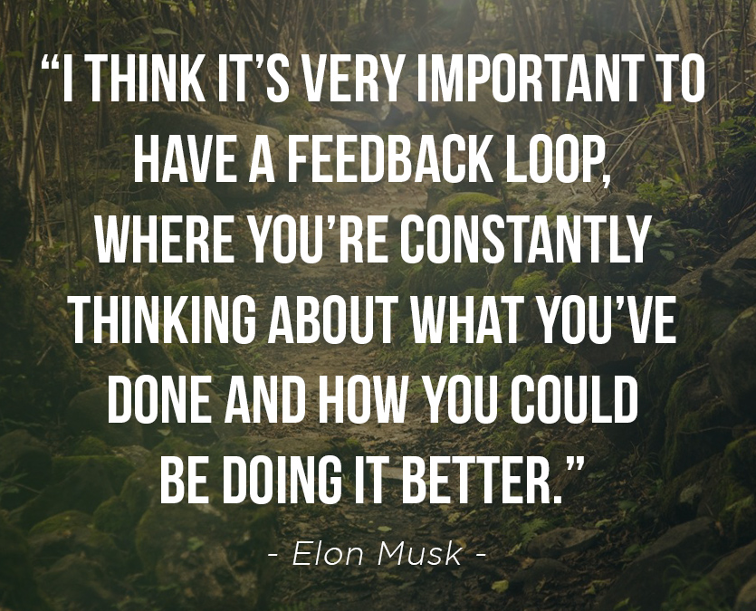
Feedback Best Practices
Feedback
Know what is in your control or their control
Set Expectations and Goals with a clear understanding of the Detail and Quality expected of your teammates
Remember feedback is a two-way street involving:
Listening
Understanding
Acting
As leaders we are often in the position of giving feedback, but we must realize the most effective leaders openly ask their employees for feedback too on what they can improve.
Notes:
Talking Points:
When giving feedback there are a few best practices to consider. Know first what is in your control or your teammate’s control. Giving them feedback on something that is out of their control would be ineffective.
Set clear expectations, make sure the goal is understood, the details and quality expected of your teammates.
Remember feedback is a two- way street be sure to listen, seek to understand and clarify understanding, and then act upon the feedback given.
Review other notes on the slide.

Slide 22

Characteristics of Effective Feedback
Feedback
Specific
Accurate
Objective
Timely
Usable
Desired by the receiver
Checked for understanding
Notes:
Talking Points
Making sure your feedback is effective is key to success. These are characteristics to utilize when giving positive or constructive feedback.
Specific: Feedback should contain specific examples rather than generalizations.
Accurate: Feedback should be factual and clear.
Objective: Feedback should be unbiased and unprejudiced.
Timely: Feedback should be given as soon as possible after the completion of a task (when appropriate).
Usable: Relate the feedback to goals and strategies so the individual can improve their performance.
Desired by the receiver: Feedback can still be effective even in those who do not actively seek it. Those who are seeking feedback will often be more motivated to improve performance.
Checked for understanding: Clarify understanding with the individual to ensure they are getting the most out of their feedback.

Slide 23
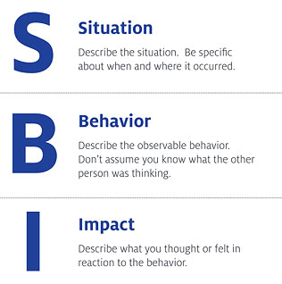
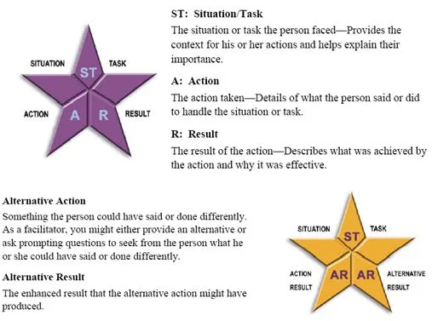
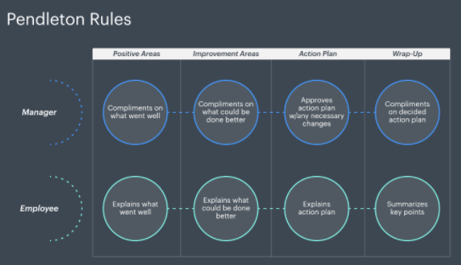
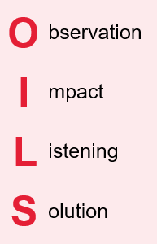
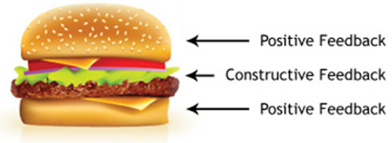
Models for Giving Feedback
Feedback
Make your feedback effective by following a framework for positive and constructive feedback
For more information on the various feedback models, please check out your resource guide.
SBI Model, Situation, Behavior, Impact Feedback Tool
STAR/AR
The Feedback Sandwich
OILS Model
Pendleton’s Model of Feedback
Notes:
This slide is animated: Positive feedback, the feedback sentence in red will appear automatically as well as the symbol.
First Click: Situation Behavior Impact Model
Second Click: STAR/AR Method
Third Click: The Feedback Sandwich
Fourth Click: OILS Model
Fifth Click: Pendleton’s Model of Feedback
Sixth Click: Review
Note: The best practice in all of these feedback models, is to listen, clarify and let the teammate/employee/receiver, be a part of developing the solution.
Talking Points
There are many models you can use in giving feedback. Here are 5 models that are notable and that align with Cardinal Health’s Leadership training. For a deeper dive of these models please see your Resource Guide or Search Feedback and Coaching in mySpark for a dedicated playlist for our Manufacturing Leaders.

Slide 24
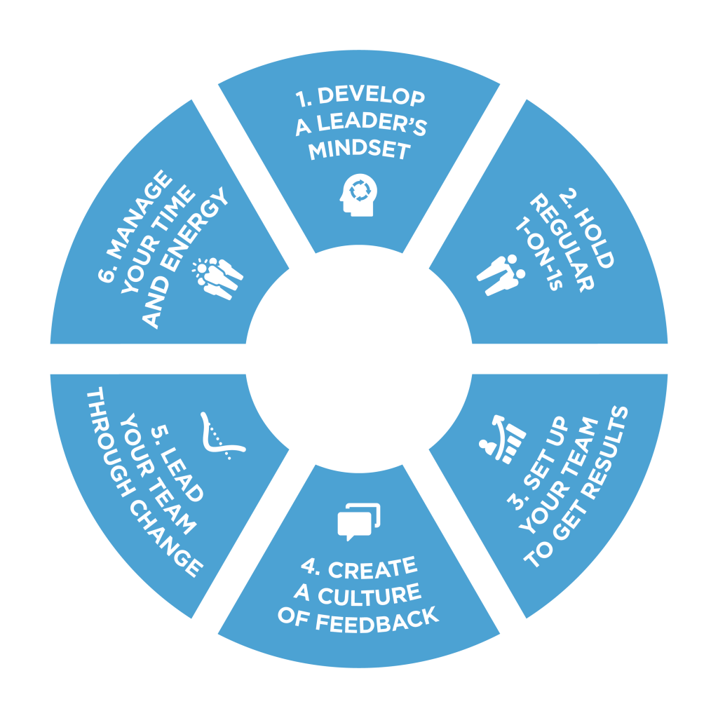
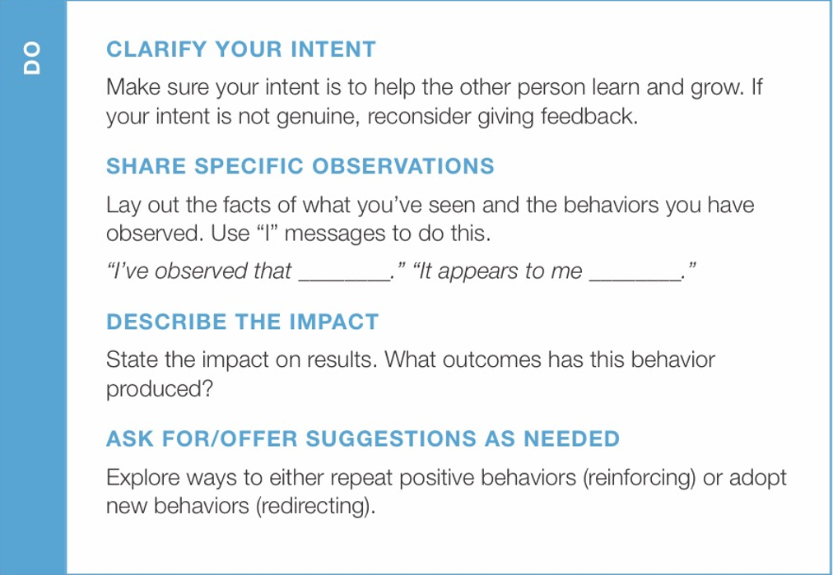
Give Honest, Accurate Feedback
Create a Culture of Feedback
Franklin Covey – 6 Critical Practices
Notes:
Talking Points
While there are many elements in the feedback models you have seen today, they are all similar. If you have already taken 6 Critical Practices as a leader this will be a refresher for the best practices suggested by Franklin Covey.
Using whichever model is comfortable to your leadership style you want to make sure to:
Clarify your intent
Share specific observations
Describe the Impact
Ask for or Offer Suggestions as Needed.

Slide 25
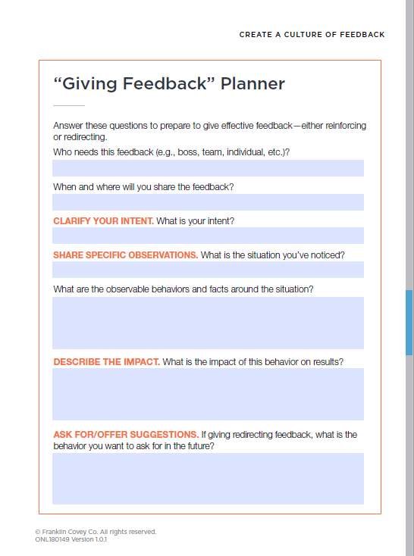
Give Honest, Accurate Feedback
Create a Culture of Feedback
Franklin Covey – 6 Critical Practices
Giving Feedback Planner
Who needs this feedback?
When and where will you share the feedback?
What is your intent?
What is the situation you’ve noticed?
What are the observable behaviors and facts around the situation?
What is the impact of this behavior on results?
If giving redirecting feedback, what is the behavior you want to ask for in the future?
Notes:
Talking Points
In 6 Critical Practices we go into more detail, but here is a link to the Giving Feedback Planner that can help you with these conversations.

Slide 26
Seeking Feedback Guidelines:
Create a Culture of Feedback – Franklin Covey
Declare your intent
Let the other person know why you want feedback. Your intent is typically to learn, develop, and get better as a leader.
Ask for Specific Feedback
Avoid asking questions that won’t generate useful information. Generic questions like “How am I doing as a manager?” won’t give you any specific insight. Instead, try the following:
“I’ve been working on___________. How could I get better?
“What, specifically, do we need to do better with respect to ___________ (system, structure, process)?”
“I’ve provided some suggestions for our 1-on-1s. What would make these meetings more valuable to you?”
Listen Empathetically
Listen to understand, not explain or defend yourself.
Acknowledge the Feedback.
“Thanks for the feedback. Let me think about how I can apply it.”
Notes:
Talking Points
As a leader, one of the most effective ways to gain employee engagement is to also ask your teammates for feedback about yourself, or about the project you are working on.
When Seeking feedback, there are some guidelines you should follow: (You may have seen this already if you took 6 Critical Practices)
Declare your intent
Let the other person know why you want feedback. Your intent is typically to learn, develop, and get better as a leader.
Ask for Specific Feedback
Avoid asking questions that won’t generate useful information. Generic questions like “How am I doing as a manager?” won’t give you any specific insight. Instead, try the following:
“I’ve been working on___________. How could I get better?
“What, specifically, do we need to do better with respect to ___________ (system, structure, process)?”
“I’ve provided some suggestions for our 1-on-1s. What would make these meetings more valuable to you?”
Listen Empathetically
Listen to understand, not explain or defend yourself.
Acknowledge the Feedback.
“Thanks for the feedback. Let me think about how I can apply it.”

Slide 27
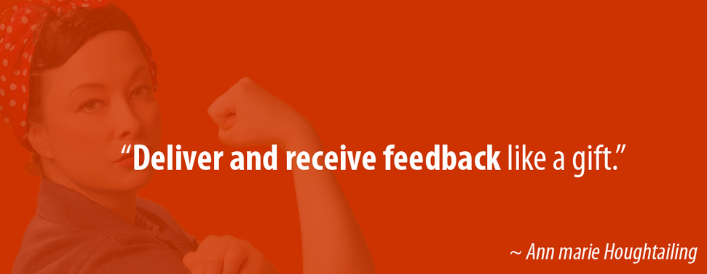
How to Receive Feedback
Feedback
Listen Attentively
Repeat only what you heard (to clarify)
Ask for specifics
Show Appreciation by saying Thank You!
Ask If (and When?) you can check back
Notes:
Talking Points
Once you have developed a culture of feedback you may receive feedback on the fly.
Here are some key tips on how to receive feedback!

Slide 28
Positive and constructive feedback are both necessary; negative feedback should be avoided
Feedback
1
Positive feedback (Reinforcing)
Simple praise, highlighting why or how the coachee did a good job
E.g. “Good job…I like the way you presented today !!!”.
2
Constructive feedback (Redirecting)
Feedback doesn’t need to be formal! You can do it anywhere, anytime, especially positive feedback!
Delivered sensitively, highlighting how the coachee could do better next time
E.g. “Your presentation was good, but you need to engage better with the audience perhaps through eye contact”.
3
Negative feedback
Destructive, merely replaying something that went wrong and describes negative behavior without proposing a solution
E.g. “Your presentation was boring”.
Notes:
This slide is animated: Positive feedback, the feedback sentence in red will appear automatically as well as the symbol.
First Click: Positive feedback will appear.
Second Click: The 2 points of Positive feedback will appear.
Third Click: Constructive feedback will appear.
Fourth Click: The 2 points of Constructive feedback will appear.
Fifth Click: Negative feedback will appear.
Sixth Click: The 2 points of Negative feedback will appear.
7th click: Reminder on Feedback will appear.
Talking Points
Positive and constructive feedback are both “positive”. They both produces beneficial rewards. Positive feedback help establish an individual performance, self-image, confidence.
Constructive feedback gives the individual information, tools, and guidance to help advance themselves, their skills and opportunities.
Negative feedback should NOT be used. It is destructive to the receiver and the giver. Does anyone have any comments?
Additional Talking points if needed:
Let’s talk about feedback, there are 3 types:
Positive, Constructive, and Negative.
What is positive feedback?
Examples that might be given: Good job, great work, way to keep it going, woo woo!
Positive feedback is great for cheering your team on and motivating your team, can be generic or specific. Definitely, specific is great at reinforcing what you liked about what they did or what they did right and that will drive confidence.
What is negative feedback?
Examples: Wrong, Horrible Job today, what were you thinking?
Negative feedback is just that, there are no wins, it degrades a team, will do the complete opposite with motivation. It devalues your initiative and your team. Have we all had someone in our lives that was a bully or didn’t know how to give feedback and this is what we got? How did it make you feel? That is exactly why we want to stay away from it.
What is Constructive feedback?
Examples: How I can do better, what you liked, what you didn’t like, suggestions to try.
If you have been through leadership training at Cardinal Health you may remember the STAR/AR method. What you did well, then what you didn’t do as well or could have done differently, identify the Action and the Result, and offer and Alternative Action and a different Result.

Slide 29

Let’s Try Practicing Your Feedback Skills!
Use the Feedback Scenario Activity Word Document for this activity.
Discuss in Small Groups How you would handle each of the following:
Scenario 1 – Bob, we have always done it this way!
Scenario 2 – Sallie, favoritism, inconsistent
Scenario 3 – Harry, not happy about his review.
Scenario 4 – Jake, always overdue
Scenario 5 – Brenda, quiet, shy, great ideas
Scenario 6 – Change Fatigue
Be prepared to share with the rest of the team!
Notes:
Talking Points:
Using the Word Document Practicing Feedback break into small groups or breakout rooms if virtual. Have each team work together to determine the feedback they would give in these scenarios.
Allow 15-20 Minutes for the discussion.

Slide 30

DEBRIEF
Use the Feedback Scenario Activity Word Document for this activity.
How did you handle the following scenarios:
Scenario 1 – Bob, we have always done it this way!
Scenario 2 – Sallie, favoritism, inconsistent
Scenario 3 – Harry, not happy about his review.
Scenario 4 – Jake, always overdue
Scenario 5 – Brenda, quiet, shy, great ideas
Scenario 6 – Change Fatigue
Notes:
Talking Points:
Let’s debrief.
Scenario 1 what are we going to tell Bob?
Scenario 2 how can we help Sallie?
Scenario 3 What can we do to motivate Harry?
Scenario 4 Jake, Jake, Jake, he isn’t being a good neighbor, how can we get him to meet his deadlines?
Scenario 5 Breaking Brenda out of her comfort zone is tough, how did you handle it?
Scenario 6 Change Fatigue – How did you address the team?

Slide 31
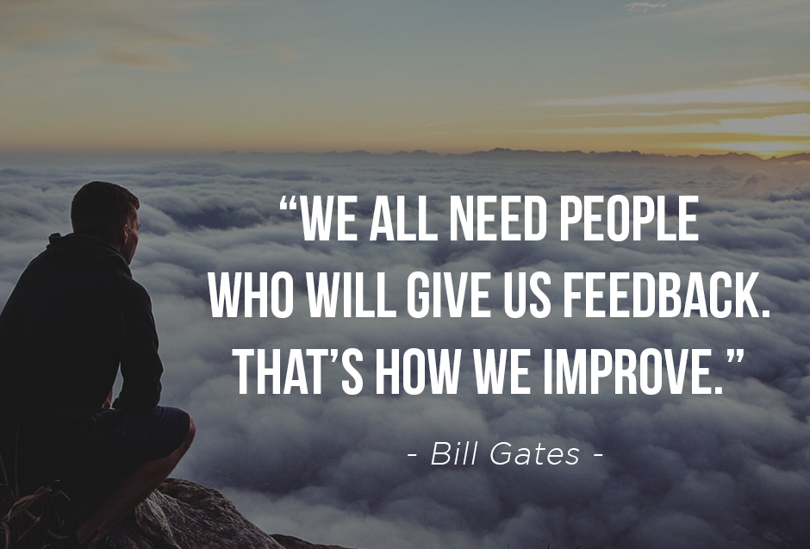
Homework
Putting your feedback skills to work for you!
Before Session 2
Put your feedback skills to the test!
Review various feedback models, use the one that works best for you!
Come prepared to discuss:
What worked well?
What do you need to improve?
Did you notice any changes with employees that you gave feedback too?
Notes:
Talking Points:
Ok now that you have practiced in here a nice safe space. We want you to apply these techniques when working with your teams and peers. You have homework. Apply the techniques and when we regroup…. On dates & time.
We want you to give us feedback, tell us what worked well, what didn’t go so well, where do you need to improve? Any success stories!

Slide 32
People- Mindsets and Behaviors part II
Playbook Learning Series
18-January-2021
Notes:
Welcome to “Today’s People - Mindsets and Behaviors” Discussion and Engagement Platform

Slide 33
Tools to use to help mindsets and behaviors ASCEND
Mentoring
Coaching
Feedback
Influence Model
Notes:
Talking Points:
Our 2nd component to ascension is “Feedback’.

Slide 34
Homework
Putting your feedback skills to work for you!
Before Session 2
Put your feedback skills to the test!
Review various feedback models, use the one that works best for you!
Come prepared to discuss:
What worked well?
What do you need to improve?
Did you notice any changes with employees that you gave feedback too?
Notes:
Talking Points: (Allow 20 Min for this discussion)
Let’s debrief, we talked about influencing others, our Cardinal Health Behaviors and Feedback.
You had homework before this session.
What feedback models did you like? What worked best for you?
Who would like to share about some of the feedback experiences they had?
What worked well?
Anyone have an example of where it didn’t go so well? Let’s see if we can help. Don’t be shy we are still learning. Have team offer suggestions when someone shares.
Where there any ah ha moments or moments in which a employee made changes because of your feedback and you saw improvements?

Slide 35

Tools to use to help mindsets and behaviors ASCEND
Mentoring
Coaching
Feedback
Influence Model
Notes:
Talking Points:
We are almost at the top. Our 3rd component to ascension is “Coaching’

Slide 36
Feedback, coaching, and mentoring can all help to change people’s mindsets and behaviors
Coaching
Description
An ongoing relationship in which the mentor is a role model, a wise friend and counselor
Personal
3
Mentoring
Usually, a repeated interaction that aims to enhance the performance and learning ability of others
Professional
2
Coaching
Robustness of Relationship
Could be a single interaction; necessary to create awareness
1
Feedback
Stranger
One-off
Repeated
Long term
Duration of Interaction
Notes:
Talking Points:
Coaching is a deliberate, ongoing, informal and formal interactions designed to enhance the person and their performance.
We will look at 2 tools that will support coaches in a minute. First, I want to show you how cost effective and beneficial coaching is..

Slide 37
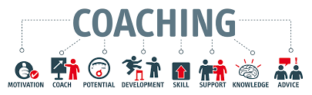
Coaching
Coaching is a form of development in which an experienced person, called a coach, supports a learner or client in achieving a specific personal or professional goal by providing training and guidance.
Notes:
Talking Points:
What do you think of when you hear the word coach?
Sports, Athletes etc.
What makes a good coach?
Motivates others, Builds Skills, Positive, Leads by Example
How is being a manager different than being a coach?
Can you be a coach and a manager?
Through our new culture being able to coach your team collectively and individually will be key to their success in not only performance and current state, but driving them towards opportunities and growth for the future.

Slide 38
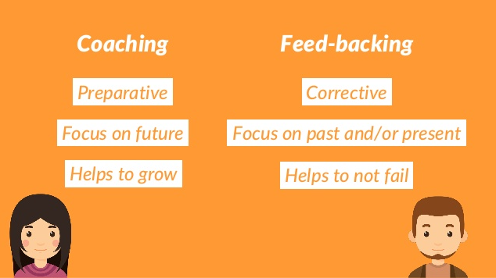
Difference between feedback and coaching
Coaching is about assisting employees reach their goals for the future. Feedback is about helping employees understand what prevents them from reaching their current goals. Coaching is about advocating optimal performance. Feedback is about reinforcing appropriate behavior.
www.rightattitudes.com
Notes:
Talking Points:
The main difference is coaching is focused on the future, where they want to go, grow, develop.
Feedback is for the immediate. Sometimes there can be overlap. Feedback is specific to a behavior.
Additional Activity if available: Story Share from a success in a site that has already gone through Manufacturing Excellence on how coaching was used.

Slide 39
The coach’s style should adjust based on the level of skill and will of the coachee
Coaching
Skill-will matrix
High
Guide
“Willing, but must develop skills”
Training and mentoring
Apprenticeship
Clear role and direction
Encouragement
Role-play
Peer coaching
Empower
“Willing and able”
Stretch assignments
Assign as mentor
Recognize and reward
Prep for promotion
Encourage risk-taking to try new approaches
Will (Employee commitment)
Direct
“Low ability, and unwilling”
Documented feedback
Development plan
Enforce minimum standards
Do not over-invest unless you can improve skill or will
Excite/support
“Able, but not motivated”
Motivational methods
Role re-design
Team re-assignment
Praise progress and small gains
Enforce minimum standards
Low
Low
High
Skill (Employee abilities)
Notes:
Talking points:
Have you heard of skill versus will. We are going to take 3 different views to this matrix. It is key as a Coach that you are able to identify where your teammates are. As with any chart like this there is a spectrum, and it can change. As you identify where your teammates likely fall then you can begin to use these tools to get them to the ideal Willing and Able state. This matrix will help you communicate as well as meet your teammates where they are at with the goal of moving them into a top performing status.
Depending on your teammate or the colleague you are working with you have to consider where they are on this Skill vs Will spectrum.
Are they willing but we need to develop them?
Are they willing and able? Which is where we would like them all to be.
Are they able but not motivated? What can we do to motivate this person?
Do they simply not have the skill or the will?
How to use skill-will matrix
Determine skill-will quadrant for the coachee for each coaching issue (might differ from topic to topic)
Adjust your coaching approach accordingly
Coach regularly throughout a project to foster the coachee’s development
Revise your coaching approach over time as coachee develops
Regular coaching can help move employees to the top right quadrant
As you meet with each person during your regular coaching cadence, determine where do they fall and how can I help them get to the Willing and Able stage?
Also consider where do you fall in one of these quad as a coach or coachee?

Slide 40
The coach’s style should adjust based on the level of skill and will of the coachee
Coaching
Skill-will matrix
High
High Directive, Low Supportive Behavior
Low Supportive Behavior, Low Directive Behavior
Direct
Empower
Will (Employee commitment)
High Supportive, High Directive Behavior
High Supportive, Low Directive Behavior
Coach
Support
Low
Low
High
Skill (Employee abilities)
Notes:
Talking points:
Let’s look at the chart a different way. What leadership style or techniques can you use to move employees to that Hi Directive, High Supportive quadrant at the top right?
Low Will, Low Skill
Give them tasks that are quick wins, must motivate them to want to do more, while also building their skills.
Low Will, High Skill
Direct the behaviors you want to see and reinforce with recognition for positive behavior
High Will, Low Skill
You will need to offer more support until these teammates build confidence in their abilities are able to self direct.
High Will, High Skill
You can use more of a Coaching style since they are already engaged, invested and have ownership.

Slide 41
How to Empower Situational Leadership = Situation + Empowering People + Result Accountability
Coaching
Skill-will matrix
High
Guide/Participate
Reduce Risks, obstacles, constraints
Provide tools, training, guidance, coaching, feedback upfront
Relax control as progress is shown
Empower
Provide freedom in job methodology
Communicate trust and recognition
Develop stretch goals, broaden responsibilities, treat as a “partner”
Will (Employee commitment)
Direct/Tell
Clear briefing, identify motives, develop vision for success
Structure quick wins, train/coach patiently
Supervise with frequent feedback and clear expectations
Excite/Sell
Identify reason for low will
Develop intrinsic motivation, incentives and value alignment
Monitor and provide recognition to reinforce positive behavior
Low
Low
High
Skill (Employee abilities)
Notes:
Talking points:
Here are things you can do for employees that fall into the various quadrants.
For Direct/Tell (Low Will, Low Skill)
Clear briefing, identify motives, develop vision for success
Structure quick wins, train/coach patiently
Supervise with frequent feedback and clear expectations
For Excite/Sell (Low Will, High Skill)
Identify reason for low will
Develop Intrinsic Motivation, incentives, and value alignment
Monitor and provide recognition to reinforce positive behavior
For Guide/Participate (High Will, Low Skill)
Reduce risks, obstacles, constraints
Provide tools, training, guidance, coaching feedback upfront
Relax control as progress is shown
Empower (High Will, High Skill)
Provide freedom in job methodology
Communicate trust and recognition
Develop stretch goals, broaden responsibilities, treat as “partner”

Slide 42

Tools to use to help mindsets and behaviors ASCEND
Mentoring
Coaching
Feedback
Influence Model
Notes:
Talking Points:
Our final and top component to ascension is “Mentoring’.

Slide 43
Feedback, coaching, and mentoring can all help to change people’s mindsets and behaviors
Mentoring
Description
An ongoing relationship in which the mentor is a role model, a wise friend and counselor
Personal
3
Mentoring
Usually, a repeated interaction that aims to enhance the performance and learning ability of others
Professional
2
Coaching
Robustness of Relationship
Could be a single interaction; necessary to create awareness
1
Feedback
Stranger
One-off
Repeated
Long term
Duration of Interaction
Notes:
Talking Points:
Mentoring is a relationship between the mentee and mentor. The mentor is a friend, counselor and role model exhibiting behaviors the mentee desires to pattern.
This relationship is built over time with mutual respect.

Slide 44
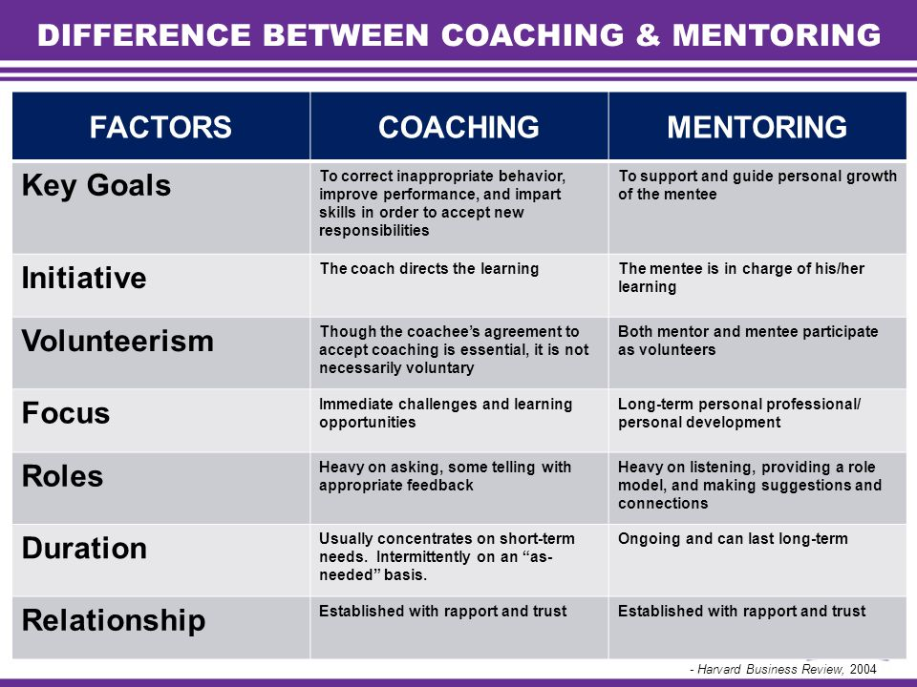
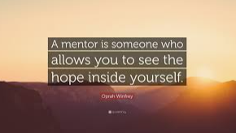
Difference between coaching and mentoring
Mentoring
Notes:
Talking Points:
Mentoring is a long-term process based on mutual trust and respect. Coaching, on the other hand, is for a short period of time. Mentoring is more focused on creating an informal association between the mentor and mentee, whereas coaching follows a more structured and formal approach.
Cardinal Health offers both informal and formal mentoring programs. Let’s take a look at the Mentee and Mentor relationship.

Slide 45

Mentee role & responsibilities
Own your development
Clarify your needs
Solicit feedback
Follow up
Be open
Apply learnings
Honor transitions
Notes:
Refer to the bullets on the slide. Emphasize that the mentee owns the relationship and is expected to take the initiative by scheduling the meetings and coming to the meetings with an agenda for the mentoring discussion.
Talking Points:
Keep in mind that to have success in any relationship, each person must do their part. To get the most out of a mentoring relationship, the mentor and mentee must follow through on their respective responsibilities.
The mentor is working in service to the mentee. Therefore, the mentee must take the initiative by identifying their development goals and clarifying how they’d like the mentor to help them achieve those desired outcomes. The mentee is expected to schedule the meetings and come prepare with an agenda for their time together.

Slide 46

Mentor role & responsibilities
Be available
Create a safe environment
Listen & ask questions
Balance empathy & challenge
Foster accountability
Build the toolkit
Broker new connections
Notes:
Talking Points:
The mentor also has responsibilities. Mentoring is a commitment, so mentors are expected to make themselves available. It’s most helpful when the mentee schedules regular meetings in advance. One of the most valuable aspect of being a mentor is to provide a safe environment for open and honest conversation. Be a non-judgmental listener. Encourage and build the mentee’s self-awareness by asking questions that broaden the mentee’s perspective. A mentor is not expected to know everything. By introducing your mentee to others who may expertise that you don’t have, a mentor can assist the mentee is expanding their network.
As we go through Manufacturing Excellence, we will identify employees who could benefit from finding a mentor/mentee relationship. If employees are interested in the Cardinal Health mentorship program that spans across the organization and is not specific to just manufacturing, please see the information made available through the Manufacturing Excellence Leadership Playlist found in mySpark.

Slide 47

mySpark!
Notes:
mySpark has a lot of valuable resources. Look for the Manufacturing Excellence Leadership Playlist by Searching the catalog for courses we have identified. Or search keywords like: Coaching, Feedback, Behaviors, Leadership, Communication.
There are a lot of great professional development opportunities to build upon your skills available.
If you need any assistance, please reach out to the Manufacturing Learning & Development Academy. Their contact information is on the next slide.

Slide 48
Leading Manufacturing Excellence the Cardinal Health Way!
Lead by example
Create a safe, inclusive environment
Drive consistency, ideation, and solutions that increase quality, safety, and productivity
Seek to understand, ask questions
Celebrate successes
Openly communicate, be transparent, but also be motivational
Be accountable.
Have those feedback conversations often
Coach your team to new heights
Be open to mentoring others
110%
Notes:
Talking Points:
Lead by Example, your teams look to you for not only direction but the tone you set.
Create a safe, inclusive environment in which your teammates will be successful and can excel in an ever-changing environment.
Drive consistency, ideation, solutions that increase quality, safety, and productivity.
Seek to understand, ask questions, work collaboratively not only with your team but your peers for best practices.
Celebrate successes and wins every chance you get.
Openly communicate, be transparent, but also be motivational in that no matter the challenge we will work towards the best solution together.
Hold yourself and your teammates accountable.
Provide feedback and solicit feedback consistently.
Coach your employees and take them to new levels of performance as well as opportunities.
Be open to mentoring others with your expertise.
Lastly, bring 110% to the table and invest in your growth and development as well as your teammates growth and development.

Slide 49
Thank you for Attending!
Please reach out if you need any additional training support, resources for your professional development.
GMB-ManufacturingLearningSOLUTIONS

